Slide 1
iPad Restaurant Application
Hyon Lee, 100488516
Kajan Ravindran, 100608620

Slide 2
Preliminary Analysis
Before any in-depth analysis, pros and cons of the project were discussed.
Pros
Ease of use (customers)
Easy menu updates
Modern appeal
Cons
Investment for hardware
Software implementation
With large investment required compared to traditional ink and paper, our focus will be to increase ease of use, and provide easy updates to the restaurants.
Notes:
Kajan
[before slide contents]
Explain little more about the ipad restaurant application and its current state in restaurant business market
The traditional restaurant experience involves reading off a menu and waiting for someone to come take your order and submit it to the kitchen
Wait time
Multiple points for error
We are now seeing more digital menus popping up in restaurants, but many of them are clunky/laggy
Purpose of preliminary analysis is to identify project goal and possible risks early on
[proceed to rest of slide content]

Slide 3
Project Objectives
As a software designed for business, objectives of the project is not only just to ensure software runs without fault, but also held at different business standards we’ve established as following:
Appropriate privilege to customers and business respectively
Restaurants should be able to add new menu items/promos
Clients should be able to order with the limited privilege given to them
Synchronized server and client system
Storefront should be notified in almost real-time once the customer makes an order
All prices changes should affect all machines
Notes:
Hyon
As a software designed for business, not only software should run without error, but also held at different business standards
Firstly software should: Appropriate privilege to customer and business: customers should not be able to change prices
Synchronized server and client: if parts of the software is cloud based, any updates made on server should reflect on clients almost real-time
E.g. client ordering food should be notified almost immediately

Slide 4
Objectives continue
Respective area of operating business should receive customer's order
If restaurant is composed of different parts (e.g. bar or dining)
Speed/quality of software
Ordering through software should be efficient than conventional waitress-notepad methods
Errors made by the software should be lower than expected
Notes:
Hyon
-third: customer’s order should be processed by respective areas of concern: so if customer orders a drink, it should be sent to the bar instead of kitchen
-fourth: is the speed and quality of the software: is software more effective than conventional waiter and errors made in software should be below any promised threshold

Slide 5
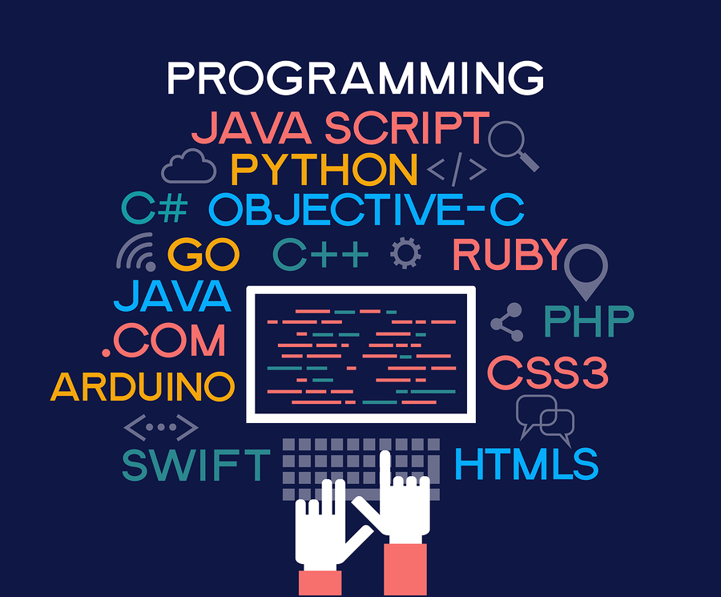

Measurement of success
As discussed in objectives, measurement of success will be based on both software project metrics (i.e. latency, downtime) and as a business product point of view (i.e. customer satisfaction, profit margin)
[img above]https://itchronicles.com/opinion/best-machine-learning-programming-language/
[img below]https://upserve.com/restaurant-insider/what-does-a-restaurant-server-do/
Notes:
Kajan
A successful software depends on a few key points
Latency - the software should not lag during user input or during submission of orders
Downtime - the software should be stable and robust
Customer Satisfaction - customers should find it more convenient to use than traditional methods
Profit Margin - Using the software should allow for reallocation of resources (ie. have staff do other tasks) and reduce lost revenue (ie. mistaken orders)

Slide 6
Measurement of success cont.
Order Failure/ error rate
Likely one of the biggest fear from the clients (software aspect)
Should never exceed threshold provided by the team
Saved cost analysis
Software approach provides cost reduction from various sources (e.g. staffing, prevention of food waste)
Notes:
Kajan
[simplified version of the two points]
Order failure error rate: biggest scare factor for clients concerning software
The system needs to be better than a human
During initial meetings with shareholders, it will be necessary to run some baseline tests for analysis purposes
Reduction in Error Analysis
How many errors will software reduce
Saved Cost Analysis
How much effenciences will save

Slide 7
Measurement of success cont.
Workplace efficiency
Software implementation reduces human to human interaction, providing shorter order turnaround time
Net profit analysis
Analysis of break-even point, and potential business gains due to software system (i.e. overlooked metrics and relations due to software implementation)
Notes:
Kajan
[simplified version of the two points]
Workplace efficiency
Shorter turnaround of orders
Less running around to receive orders
Net profit analysis
Analysis to be conducted with shareholder to compare increased profits due to software implementation due to factors like
Less wait staff needed
Faster service times translate to more guests

Slide 8
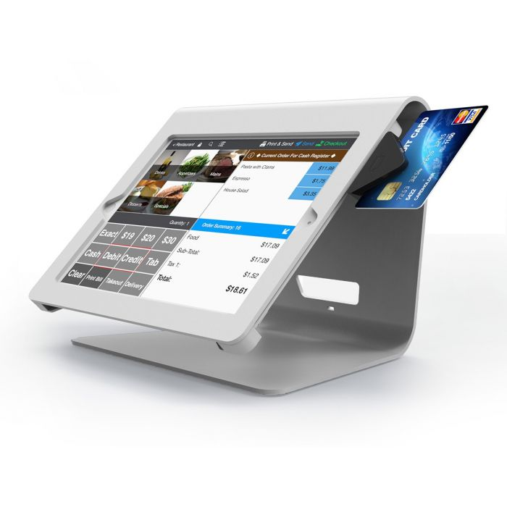
Project Infrastructure: Off-the-shelf
As personalized POS system gets more available, there exists “off-the-shelf” product where our team can fine tune the modularized components to create our own product.
Our first testing for infrastructure will be to perform cost analysis of popular “off-the-shelf” software.
Benefits of off-the-shelf
Cons of off-the-shelf
[img]https://www.maclocks.eu/de/nollie-ipad-kiosk-ipad-pos-kiosk.html
Notes:
Hyon
There are alternative solutions to building the product. The first one is to utilize off-the-shelf product.
Lot of freedom
Modularized components to build our product
During the initial planning stage, we should test
-benefits off the shelf
- and negatives of the off-the-shelf (maybe lack of customization as we exepct)

Slide 9

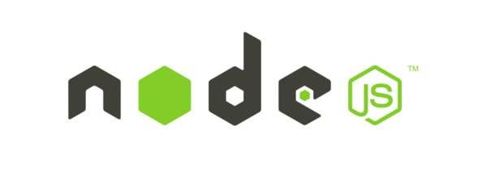

Project Infrastructure: In-house
Based on team discussion, largest part of client based is expected to be small to medium-size business. Considering situation given, we choose waterfall/Iterative-style development**
A three-tier system with data, application and client layer.
Data: local or cloud (based on business size) Application: application hosted on node or locally Client layer: application created using Swift or react native
Notes:
Hyon
To build our application from scatch up.
Our goal is to appeal to small and mid size restaurant business with possiblities of chain restaurant
We chose waterfall / iterative style development
This means while we are working with client, we would provide iterative style development, but once the contract is over, we consider it as waterfall - where we don’t look back at it twice.
Three tier system with data, application and client layer.
Data: locally or cloud (based on business size)
Application: is either hosted using node or locally on machine
Client layer: application created using swift or react native

Slide 10

Risks and countermeasures:
Development
Bugs - addressed during user testing(subtask) - Prototype creation for new features, and frequent testing conducted by both the development team and external testing team
Shareholder modifying requirement during development - Despite waterfall/iterative style. Frequent contact with client during development - Frequent deliverables and prototypes to ensure expectations are translated into product
Unexpected concerns (e.g. emergency outbreak) -Healthy policy to ensure safety of employees (i.e. work from home)
[img]https://medium.com/mutualmobile/ios-bug-fixing-getting-rid-of-programming-pests-3464c52a728b
Notes:
Hyon
[before slide contents]
Before moving on, we should point out the two risks and countermeasures we’ve applied to the final project file (both highlighted on this page and nextpage )
Bugs: self explanatory
Shareholder modifying requirement: self explanatory
Unexpected concerns: this is a risk added to protect the employees to provide safety during unexpected emergency - e.g. during outbreak, work from home

Slide 11

Risks and countermeasures:
Deployment
Hardware and software incompatibility - Test deployment on various hardware versions
Shareholder dissatisfaction - addressed in prototype development & concept development (subtask) - Frequent updates for shareholder during development - Consultation to assess what can be done
Outdated hardware or hardware slow down by manufacturer - Test deployment on various version and hardwares to provide alternatives to customers
[img]https://www.realbusinessgroup.com.au/4-root-causes-customer-dissatisfaction/
Notes:
Hyon

Slide 12
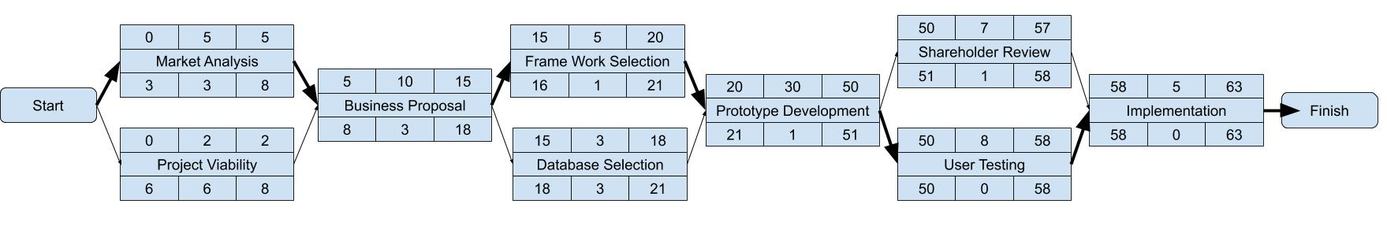
Project Activity: Activity Diagram
Notes:
Kajan
Overall activity diagram
Not showing sub-tasks, which can be seen in detailed view
Showing parallel activities to cut down on overall time
Critical Path

Slide 13
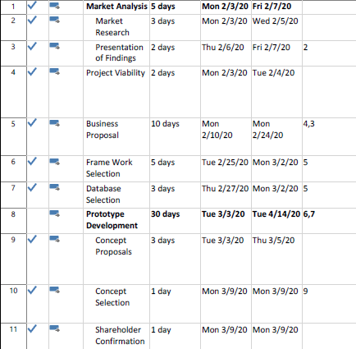
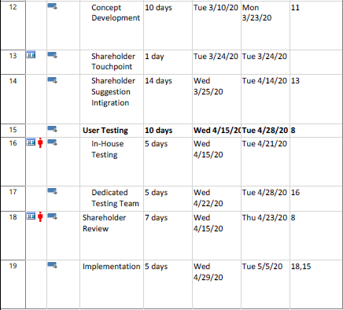
Project Activity: detailed view
Notes:
Kajan
Detailed view shows subtasks
Also shows the mitigation
Shareholder Dissatisfaction (Red Boxes)
Resolved in multiple points of Shareholder Reviews
Task 11: Shareholder Confirmation of selection of proposed concept
Task 13: Shareholder Touchpoint during the development of the concept
Task 18: Shareholder Review to confirm operation of the developed product
Unforeseen Bugs (Orange Boxes)
Resolved in two key points of User Testing Summary task
Task 16: In-House Testing performed by key members of development team
Task 17: Dedicated Testing performed by Testing Team

Slide 14
Resources available
There are total 6 roles created for the project
Full stack programmer - Hyon
Tech lead- Kajan
Database administrator
Business Analyst (combined with Sales Lead)
Client Relations
Testing Team
Notes:
Hyon

Slide 15
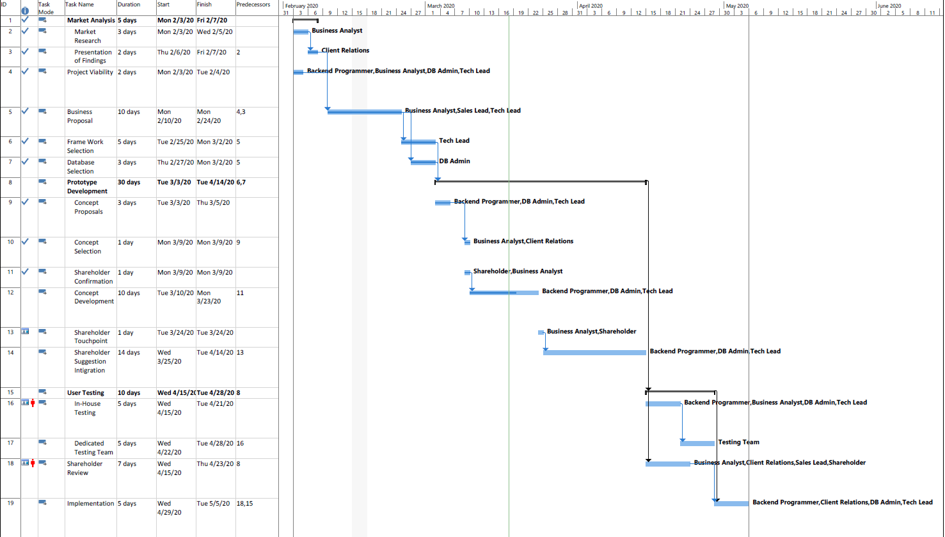
Project Gantt chart
Notes:
Kajan
Generated from our Activity Diagram & Detailed View
All Tasks have been assigned to at least one role

Slide 16
Conclusion
Technology is a growing area in restaurant business market
Clear project objectives
Measurement of success calculated accordingly
Workaround for small team and limited resources
Notes:
Hyon
-Technology is a growing area in restaurant business market
-From analysis, we established clear project objectives to counter the side effects the project.
-As a business software, measurement of success needs to be measured both technically and in business perspective
-Despite small team and limited resources, work is allocated to maximize efficiency in waterfall/iterative development model

